Slide 1


Biology in a Box
A science education outreach program brought to you by a partnership
between The University of Tennessee and the National Institute for Mathematical and Biological Synthesis
Visit us on the web at http://biologyinabox.utk.edu
Biology in a Box Team
Program Director/Author/Lead Editor: Dr. Susan E. Riechert (University of Tennessee)
Science Collaborators: Dr. Thomas C. Jones (East Tennessee State University), Dr. Stan Guffey (University of Tennessee)
Mathematics Collaborators/Editors: Dr. Suzanne Lenhart (NIMBioS), Kelly Sturner (NIMBioS), Lu Howard (University of Tennessee)
Outreach Coordinator: Dr. Lynn Champion (University of Tennessee)
Workshop Coordinators: Kathy DeWein (Austin Peay State University), Gale Stanley (Jacksboro Middle School)
Production/Assistant Editor: J.R. Jones (University of Tennessee)
Previous Contributors: Sarah Duncan, Communications (formerly with NIMBioS), Rachel Leander, Math Collaborator (formerly with NIMBioS)
This unit revised October 2012
Copyright 2012 by Biology in a Box, and the University of Tennessee. All materials in this unit and on the Biology in a Box web server (biologyinabox.utk.edu, eeb.bio.utk.edu/biologyinbox) may not be reproduced or stored in a retrieval system without prior written permission of the publisher, and in no case for profit.

Slide 2
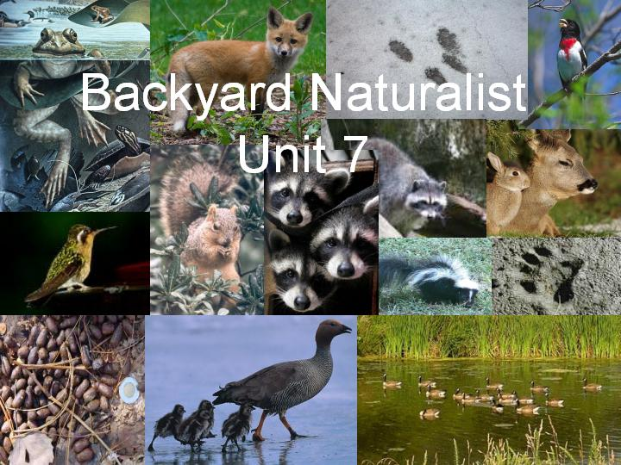
2

Slide 3
Homepage Unit 7: Backyard Naturalist
Click on underlined text to go to information and exercises!
Materials List
(Best not to let students see Materials List until after they have completed Exercises 1 & 2!)
Introduction
Exercise 1. Who Walked Here?
Exercise 2. The Scoop on Poop
Exercise 3. Getting to Know the Animals
Exercise 4. Birdsongs & Things That Go Bump in the Night
Animal Track Identification Guide
Animal Scat Identification Guide
Animal Fact Sheets
Picture Guide to Birds
Picture Guide to Night Animals
Suggested Reading
Links
Clicking the icon on other slides will bring you back to this page!

Slide 4
Introduction
As residents of Tennessee, we share the land with a wide variety of animals.
Some animals are easy to find, because they live out in the open where we can see them.
Many of the animals that live around us, however, are secretive or only come out at night.
Naturalists, or scientists who study the natural history (life cycles, diet, habitat, etc.) of organisms by observing them (or signs left by them) in their natural habitats use
  animal tracks
  their poop (scat)
  sounds they make
to identify their presence and learn about where they live.
4

Slide 5
The student will…
Learn about the animals found in this state by observing
  the tracks they make,
  the poop they leave behind,
  and the sounds they make.
In doing so, students will become more well-learned naturalists themselves!
5

Slide 6
Exercise 1. Who Walked Here?
One of the best ways to tell what animals are in your backyard is by the tracks they leave behind.
Every animal has a unique footprint and when it travels over soft ground, it leaves an impression of this footprint by which it can be identified.
In this exercise, you will be detectives, making decisions about animal identities on the basis of the tracks they produce.
Super Solver Question: What additional information can we learn about an animal by examining the tracks it has made? Click for the answer!
6

Slide 7
Answer to SuperSolver Question
By examining an animal’s tracks, we can determine a lot about the organism that made it, such as
Approximately how long ago the animal made the track. As a track ages, its edges become less sharp. This, of course, is affected by weather.
How big an animal is, as a heavier animal will have a deeper print and a larger animal a larger print. Depth, of course, will be affected by how soft the ground is at the time the animal traveled across it.
We can get some information about how fast the animal was traveling by the spacing and pattern of the footprints.
By following a track, one can get some idea of the home range of the animal.
7

Slide 8
Objectives
Click the underlined links to go to each particular sub-exercise, based on grade level and classroom topics:
Exercise 1a. Matching Animal Tracks: Matching provided tracks to animal pictures (Grades K-1)
Exercise 1b. Measure those Tracks: Recording, organizing, & analyzing measurements of animal tracks, searching for biological explanations (Grades 2-12)
Exercise 1c. Key those Tracks: Using dichotomous keys to identify tracks (Grades 4-12)
Exercise 1d. Bonus Game: Feel those Footprints: Identifying tracks non-visually (Grades K-12)
Exercise 1e. Fossil Footprints - How Fast Was that Dinosaur Moving?: Using tracks and math to estimate dinosaur (and other animal) speeds! (Grades 6-12)
Backyard Naturalist Track Identification Guide
8

Slide 9
Exercise 1a. Matching Animal Tracks
Materials:
Set of animal tracks cast in resin
Set of sheets, each with pictures of the tracks and animals that made, them along with the names of the animals.
  Alternatively, teachers may use the slides in this presentation in place of these sheets, as explained on the following slide.
9

Slide 10
Directions for Exercise 1a. Matching Animal Tracks
The teacher will spread the tracks out on a table in front of the class
Each one of the next series of slides will display the name of an animal, then its picture, and finally the track it makes.
First see, if anyone recognizes the name.
The picture of the animal can then be brought up along with a picture of the track it makes.
The first student to identify the animal can have the 1st try at finding the track on the table that matches the one displayed with the animal.
Click on the picture of the animal if you would like to learn more about the animal.
Repeat for as many animals as you care to try. There are 18 in all.
10

Slide 11
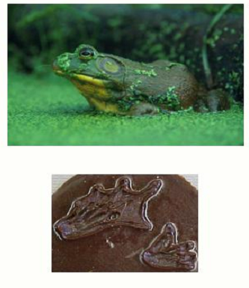
Bullfrog
Click on the animal for information about it!
11

Slide 12
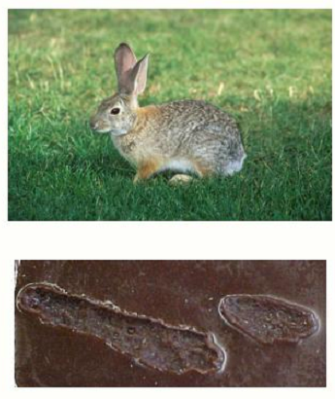
Eastern Cottontail Rabbit
Click on the animal for information about it!
12

Slide 13
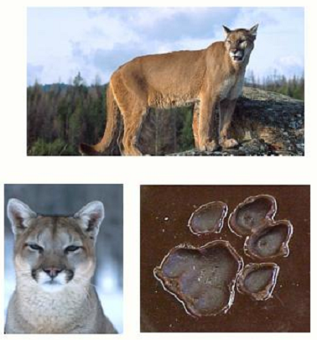
Mountain Lion or Cougar
Click on the animal for information about it!
13

Slide 14
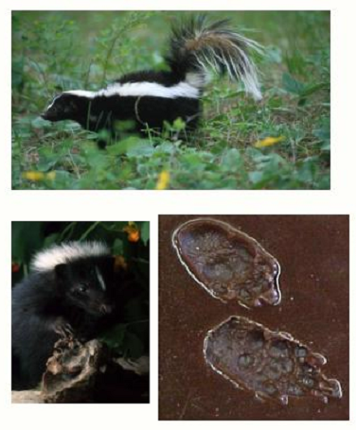
Striped Skunk
Click on the animal for information about it!
14

Slide 15
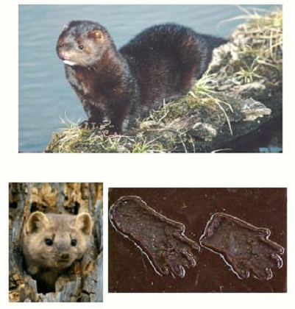
Mink
Click on the animal for information about it!
15

Slide 16
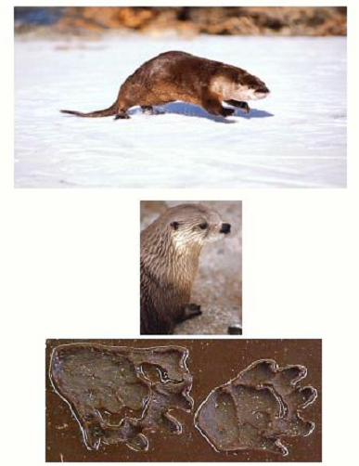
River Otter
Click on the animal for information about it!
16

Slide 17
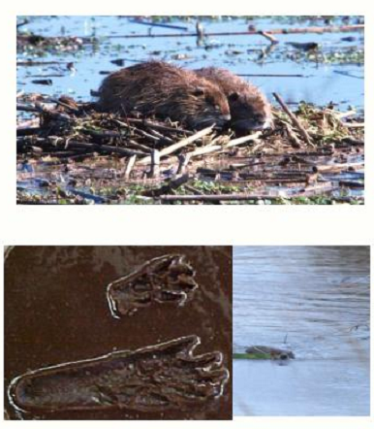
Muskrat
Click on the animal for information about it!
17

Slide 18
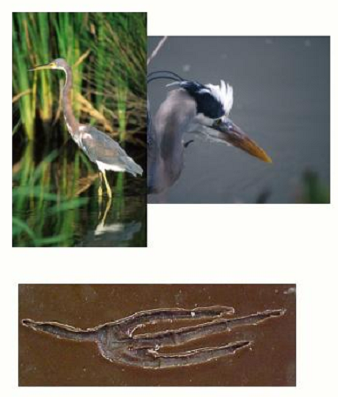
Great Blue Heron
Click on the animal for information about it!
18

Slide 19
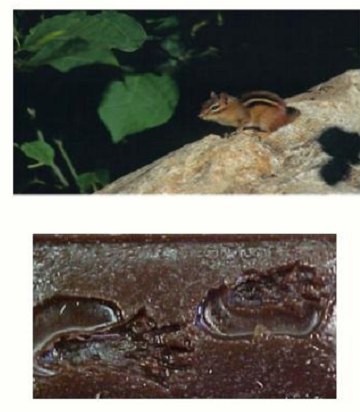
Eastern Chipmunk
Click on the animal for information about it!
19

Slide 20
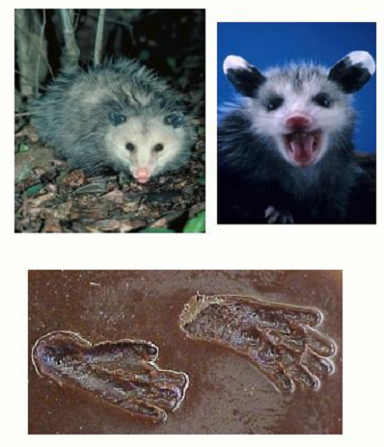
Virginia Opossum
Click on the animal for information about it!
20

Slide 21
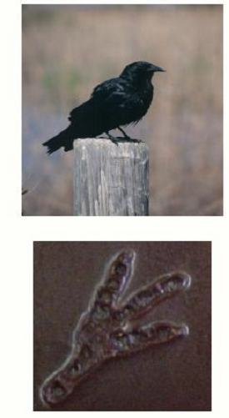
American Crow
Click on the animal for information about it!
21

Slide 22
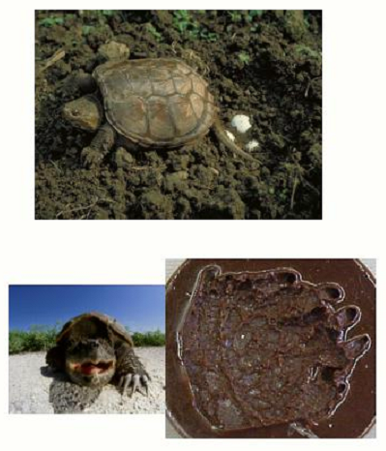
Common Snapping Turtle
Click on the animal for information about it!
22

Slide 23
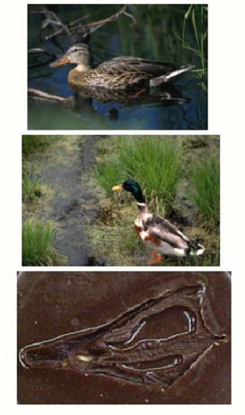
Mallard Duck
Click on the animal for information about it!
23

Slide 24
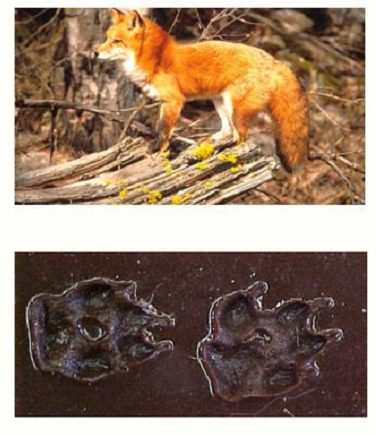
Red Fox
Click on the animal for information about it!
24

Slide 25
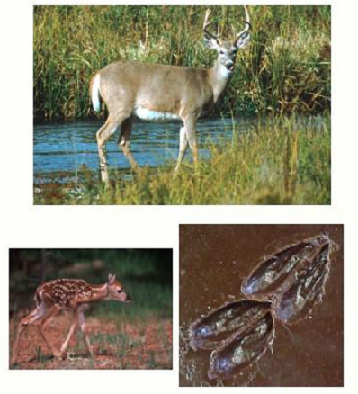
White-Tailed Deer
Click on the animal for information about it!
25

Slide 26
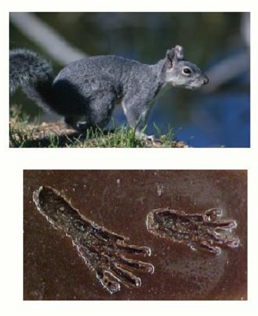
Eastern Grey Squirrel
Click on the animal for information about it!
26

Slide 27
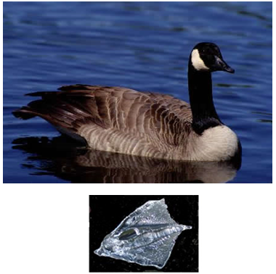
Canada Goose
Click on the animal for information about it!
27

Slide 28
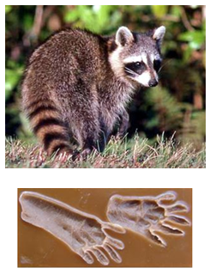
Raccoon
Click on the animal for information about it!
28

Slide 29
Exercise 1b. Measure those Tracks
In this exercise, you will collect, organize, and analyze animal track measurements.
Find the set of animal tracks cast in resin.
Select an animal track to identify.
Note the letter on the track’s label.
Use the ruler to measure the tracks (in cm), and record your measurements in a table like the one HERE.
  NOTE: Some tracks only show one foot. In this case, you should consider the foot to be a back foot.
Use your measurements and a calculator do calculations required to complete the table.
For calculating track area, you could simply multiply track length × width, or use the formula for the area of the shape that most closely approximates the shape of the track.
For information on using a centimeter ruler, click HERE, and for information on calculating area, click HERE. Otherwise, click HERE to move on.
29

Slide 30
Exercise 1b. Measure those Tracks
Your centimeter ruler will look something like the picture below with each numbered section divided equally into ten smaller sections.
(If your ruler also has inches on one side, be sure to only use the centimeter side of the ruler for this exercise!)
The numbers represent centimeters, while the smaller sections represent millimeters.
Each centimeter is divided into 10 equal sections, so each millimeter is 1/10 of a centimeter.
If you measure a length that is 2 small sections past the number 3, then you have two centimeters + 2 millimeters, which is written 3.2, meaning 3 and two-tenths centimeters.
30

Slide 31
Exercise 1b. Measure those Tracks
Area is the measure of the space inside a region.
You can also say area is a measure of covering because it measures how much space would need to be covered to completely fill in the figure.
For example, the area of a rectangle is the space within, or inside, the edges of the rectangle.
How area is measured depends on the shape of the figure. Different shapes have different formulas, or methods for finding their area.
Click a shape below to see how to calculate the area of that shape, or click HERE to move on.
31

Slide 32

Exercise 1b. Measure those Tracks
Look the rectangle below. This rectangle is 4 units across (length) and 3 units down (width).
Both the length and width of the rectangle have been divided into those units with dashed lines to show you the amount of covering it takes to completely cover the space inside the rectangle.
Count the number of individual squares made by the dashed lines inside the rectangle. How many do you find?
Look closely at the length and width of the rectangle. The length of the rectangle is 4 units, and the width of the rectangle is 3 units.
What is 4 x 3? Is the answer to 4 x 3 the same number you got when you counted the squares inside the rectangle? (It should be!)
The formula for finding the area of a rectangle is A = l x w, with l being the length and w is the width.
32

Slide 33
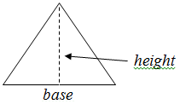
Exercise 1b. Measure those Tracks
Look at the triangle below.
The dashed line indicates the height of the triangle, which is the distance from the base, or bottom, of the triangle, to the opposite vertex, which is the ‘corner’ of the triangle directly across from the base of the triangle.
To find the area of the triangle, multiply base x height and divide by 2.
Or, to say the formula another way, the formula for finding the area (A) of a triangle is A = ½ b x h.
33

Slide 34
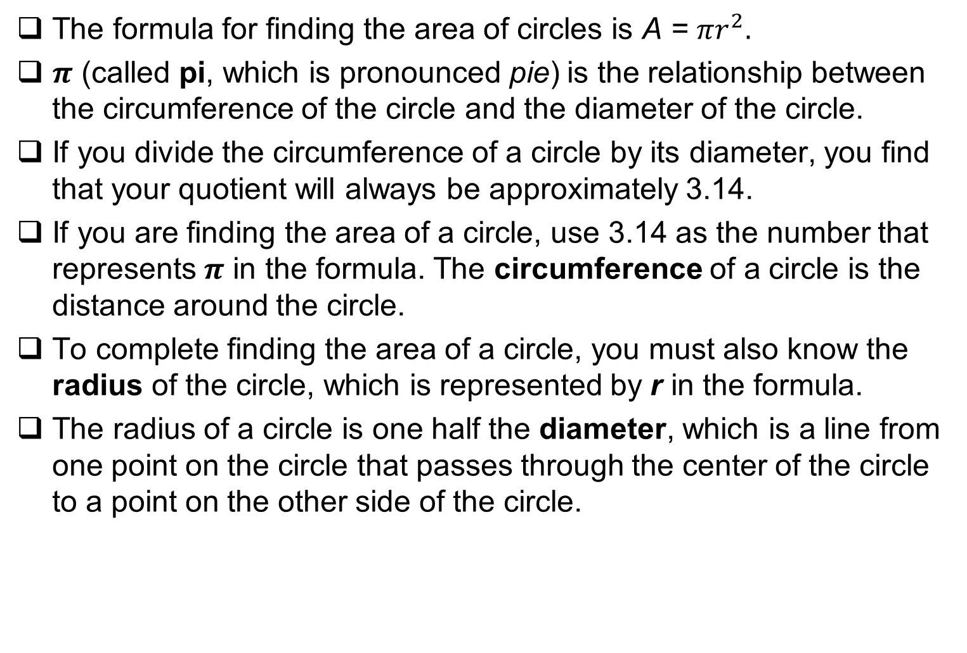
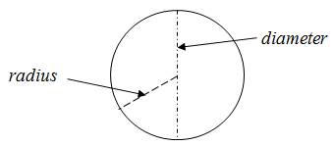
Exercise 1b. Measure those Tracks
34

Slide 35
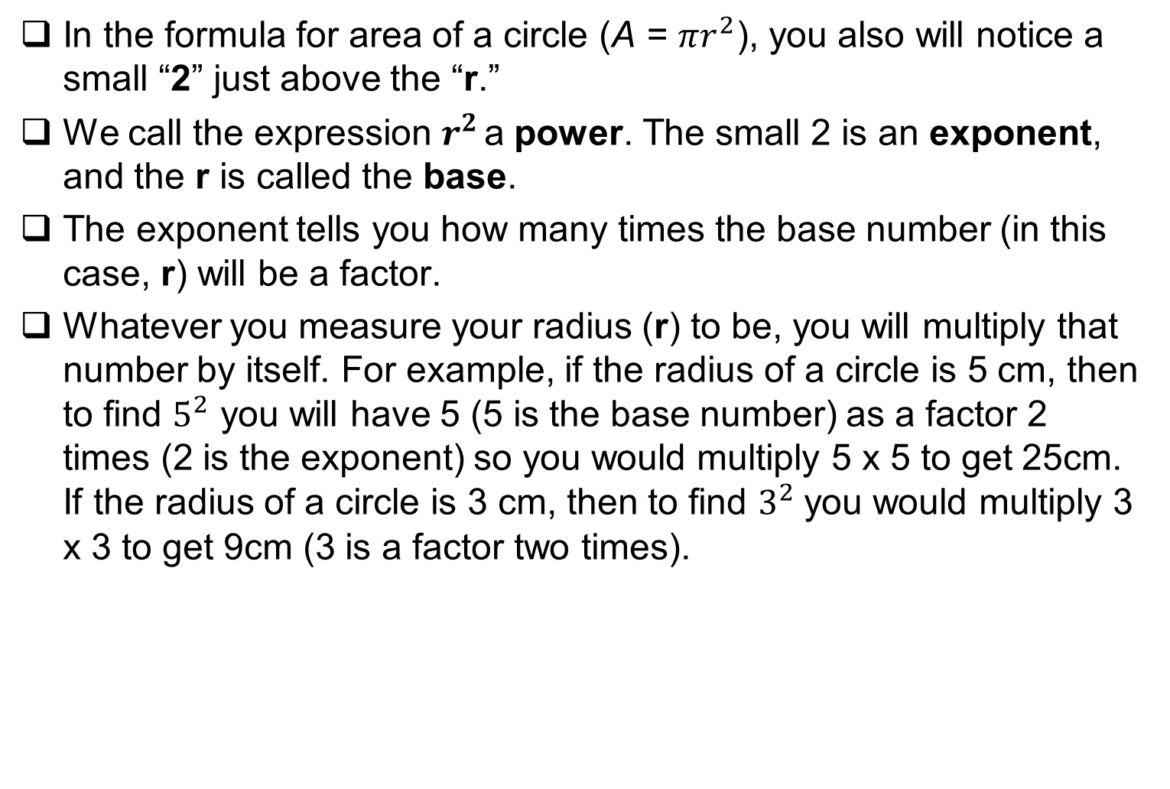
Exercise 1b. Measure those Tracks
35

Slide 36
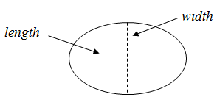
Exercise 1b. Measure those Tracks
An ellipse is an oval-shaped curved figure.
If you need to find the area of an ellipse, you will use the formula A = π x width x length.
You will use 3.14 for π just as you do for circles.
The width of the ellipse should be measured at its widest point, and the length of the ellipse should be measured at longest point. Look at the ellipse shown below.
36

Slide 37
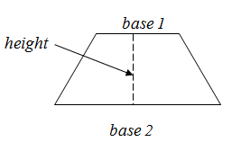
Exercise 1b. Measure those Tracks
The formula for finding the area of a trapezoid is
A = height x ½ x (base 1 + base 2)
Look at the trapezoid below with the height and both bases labeled. The bases are the two sides that are parallel to each other.
Measure the length of both bases and find the sum of those lengths (add the bases together). You will also measure the height of the trapezoid.
Using the formula, you will multiply the height by ½, which is the same as dividing by 2. Multiply that number by the sum of the bases to find the total area of the trapezoid. If base 1 = 5 cm, base 2 = 7 cm, and the height = 6 cm, the area of the trapezoid is equal to 6 x ½ x (5+7) = 3 x 12 = 36 cm².
37

Slide 38
Exercise 1b. Measure those Tracks
Track label | A | B | C | D | E | F | G | H | I | J | K | L | M | N | O | P | Q | R
Length (FF)
Length (BF)
Width (FF)
Width (BF)
Area (FF)
Area (BF)
BFL/FFL
BFW/FFW
BFA/FFA
FF = front foot, BF = back foot, L = length, W = width, A = area
After you complete your table, use it to answer some questions on the following slides!
38

Slide 39
Exercise 1b. Measure those Tracks
Q1. In general, how does the length of an animal’s back foot compare to the length of its front foot? Click for the answer!
In general, the width of the back foot is about the same as the width of the front foot.
Q2. In general, how does the width of an animal’s back foot usually compare to the width of its front foot? Click for the answer!
In general, the length of the back foot is usually greater than the length of the front foot.
39

Slide 40
Exercise 1b. Measure those Tracks
Q3. In general, how does the area of an animal’s back foot usually compare to the area of its front foot? Click for the answer!
In general, the area of the back foot is usually greater than the area of the front foot.
Q4. Can you think of some biological reasons for the trends in foot length width, and area ratios you observed? Click for the answer!
Many animals have powerful back legs that propel them forward. Larger back feet help support such legs, and increase leverage when pushing against the ground. Many animals improve their vantage point by standing up on their back feet. Larger back feet provide an animal with more stability in such a position. Also, many animals use front feet to perform functions that require precision. Small feet are better suited to such tasks.
40

Slide 41
Exercise 1b. Measure those Tracks
Q5. Can you think of any biological reasons why the trends you observed in foot length ratios might differ from those you observed in foot width ratios? Hint: In what direction do most animals move? Click for the answer!
Most animals move primarily in a forward direction. Longer feet provide an animal with more leverage when it is moving forward. When an animal is moving forward wider feet might actually slow the animal down by creating drag.
41

Slide 42
Exercise 1c. Key Those Tracks
Biologists often identify organisms by using a guidebook called a 'key'.
A key asks a series of questions that allows us to narrow down what we are looking at and ultimately permits us to identify what an organism is.
Identification keys are a lot like the “choose your adventure” books you may have read (“to fight the dragon, go to page X,” or “to run away, go to page Y.”)
Just as in those books, in keys, you keep making choices (regarding the object/organism in question) until you reach the end (the identity of the object or organism.
42

Slide 43
Exercise 1c. Key Those Tracks
The most commonly used type of key is a dichotomous key.
These are organized as a series of descriptions, grouped in pairs (couplets), from which you choose the description which best fits the object you are trying to identify.
Because you are always choosing the best option from a pair of descriptions, this type of key is called a dichotomous (two choice) key. (“Dichotomous” means “dividing into two parts.”)
When you select the description from a couplet that best fits your specimen, it will either tell you which couplet to go to next, or give you the name of the object you are attempting to identify.
The next slide presents an example of a dichotomous key.
43

Slide 44
Examine the example dichotomous key designed to distinguish among items A-D below.
As a class, pick one item at a time to identify using the key.
Once you are comfortable using a key, you can use these skills to identify animal tracks and scats in your box!
1a. Object has a hole in the center.............................go to 3
1b. Object does not have a hole in the center...........go to 2
2a. Object has a groove in the top ..............................Screw
2b. Object does not have a groove in the top.................Nail
3a. Object is hexagonal ....................................................Nut
3b. Object is circular...................................................Washer
44

Slide 45
Directions
Set up stations around the room, with an animal track cast or scat at each station.
Divide the class into groups of 2-4 students.
  Each group should be provided a copy of 'The Backyard Naturalist Key To Animal Tracks’ and ‘The Backyard Naturalist Key to Animal Scats’.
Each group should make a list of letters on a sheet of paper (A-R for tracks, A-H for scats).
On arriving at a station, the group should follow the key until the name for the animal that made the track or scat at the station is determined.
Record the animal type next to the letter identifying the track/scat. Repeat until all stations are visited.
To key animal tracks
(Exercise 1c)
To key animal scats
(Exercise 2b)
45

Slide 46
The Backyard Naturalist Key To Animal Tracks
Directions:
Begin at the first couplet of descriptions, read them both and select the option which best describes the track you are looking at.
Follow the directions given by that option. Continue until the option you have chosen identifies the animal track.
Click the underlined name of an animal in the key to find out more information about it.
Below are some features of tracks with which you should be familiar.
46

Slide 47
1a. Track triangular/fork-shaped, with three forward-pointing toes, & one backward-pointing toe…………………Go to 2
1b. Tracks not as above……………………………………Go to 3
2a. Track shows distinct webbing between toes………Go to 4
2b. Track does not display webbing……………………..Go to 5
3a. Tracks heart-shaped, showing only two toes per foot ………………………………………………….White-tailed deer
3b. Tracks not as above……………………………………..Go to 6
4a. Track nearly as wide as it is long……………Canada Goose
4b. Track clearly longer than wide……………….Mallard Duck
5a. Track less than 6 cm long……………………American Crow
5b. Track greater than 6 cm long……………..Great Blue Heron
47
continued

Slide 48
6a. Claws not visible on track(s)…………………………Go to 7
6b. Claws visible in at least the front or hind track……Go to 8
7a. Track mostly round, with clear foot pad and four similarly-sized toe pads…………………………………..Mountain Lion
7b. Tracks elongated, with variable toes, or toes difficult to see………………………………………………………Go to 9
8a. Track appears scaly……………..Common Snapping Turtle
8b. Track does not appear scaly…………………………Go to 10
9a. Elongated toes of differing sizes visible; track may display webbing………………………………………..Bullfrog
9b. Toes difficult to see in track, may appear obscured from prints of thick fur…………………………..Eastern Cottontail
48
continued

Slide 49
10a. Track shows only 4 toes on front and hind feet…Red Fox
10b. Track shows > 4 toes on front/hind foot…………..Go to 11
11a. Track shows 5 toes on both feet……………………Go to 12
11b. Track w/ 4 toes on front foot, 5 on hind foot…...Go to 13
12a. Foreprint may only show 4 toes, or 5th toe is much smaller, hind track may appear webbed…………..Muskrat
12b. Tracks not as above……………………………..Go to 14
13a. Hind print > 0.5 cm (50 mm) long…Eastern Grey Squirrel
13b. Hind print < 0.5 cm (50 mm) long……Eastern Chipmunk
14a. Hind track nearly as wide as long; may appear webbed…………………………………………………..River Otter
14b. Hind tracks longer than wide, no webbing……Go to 15
49
continued

Slide 50
15a. Claws clearly visible on foreprints, less so (or not present) on hindprints………………………Striped Skunk
15b. Claws visible on both fore- & hindprints...........Go to 16
16a. Foreprint 30-40 mm wide……………………………….Mink
16b. Foreprint greater than 40 mm wide………………Go to 17
17a. Hindprint with “thumb” angled greatly away from other toes…………………………………………Virginia Opossum
17b. Hindprint not as above……………………………Raccoon
Time to check your answers!!!
Go to the next slide to see how many you got right.
50

Slide 51
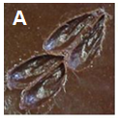
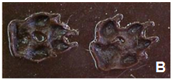
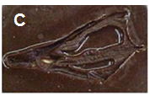
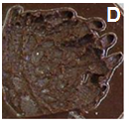

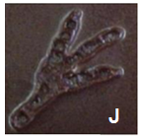

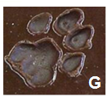


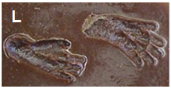
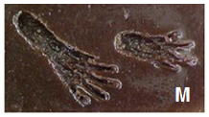
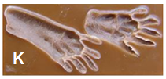
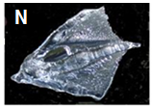
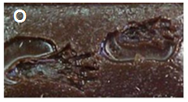
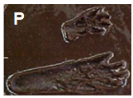
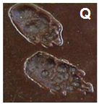

Backyard Naturalist Track Identification Guide
Click the image of a track below to find out what animal made the track!
Click the button for the “Track ID Guide” on each animal page to come back to this guide!
51

Slide 52
Bonus Game: Feel Those Footprints!
Imagine you were camping at night and something walked by your tent, but your fire burned out, and your flashlight batteries died. Do you think you could identify the animal by the way its tracks feel?
The teacher will put a track in the cloth bag while the class is looking away.
The teacher will identify a volunteer(s) who will reach into the bag and attempt to identify the animal that made the track simply by its feel.
The students might wish to practice this skill by holding tracks behind their backs.
With practice, do you do better at identifying a track by its feel?
52

Slide 53
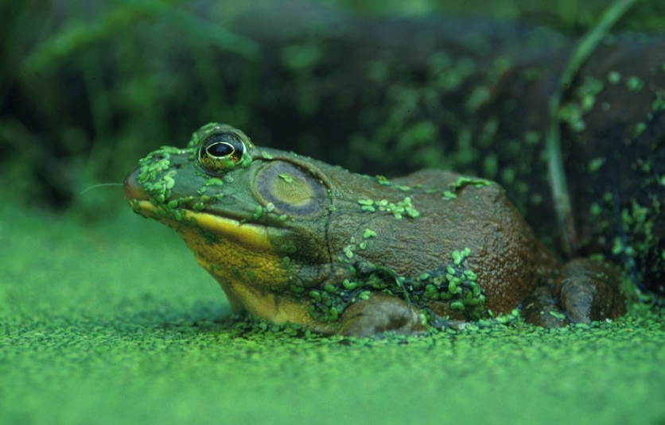
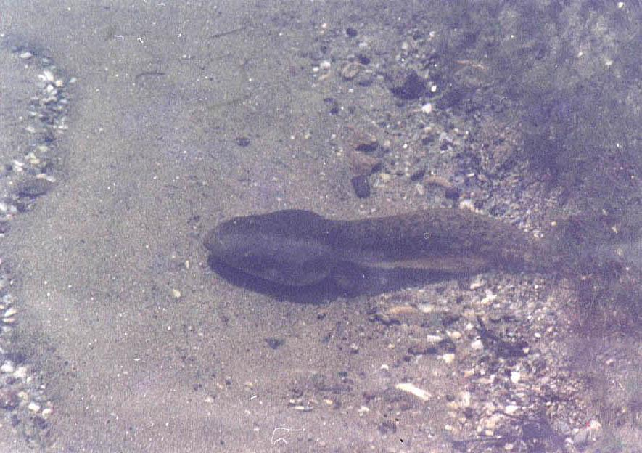
Bullfrog (Rana catesbeiana)
Class: Amphibia (Amphibians)
Order: Anura (frogs & toads)
Family: Ranidae (true frogs)
Habitat: Aquatic/semi-aquatic (near and in ponds, lakes, streams, etc.)
Diet: Carnivore (insects, worms, & other small animals, including other frogs)
Comments: Females can lay up to 20,000 eggs in a filmy mass. The eggs hatch into tadpoles, and may take up to 3 years to mature before they metamorphose into adult frogs.
Adult
Tadpole
K-1 match
Track Key
Track ID Guide

Slide 54
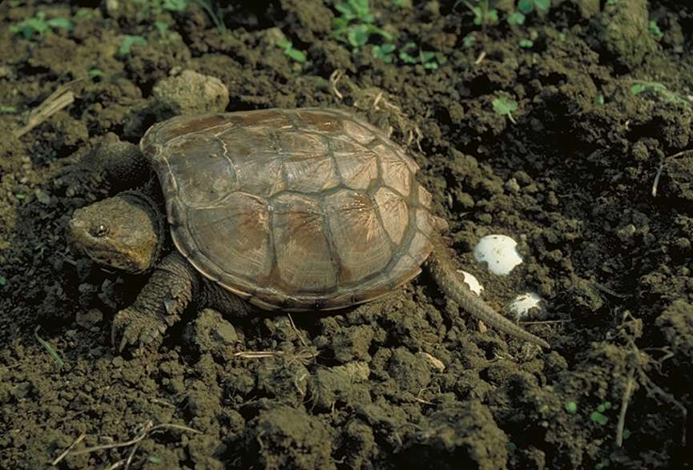
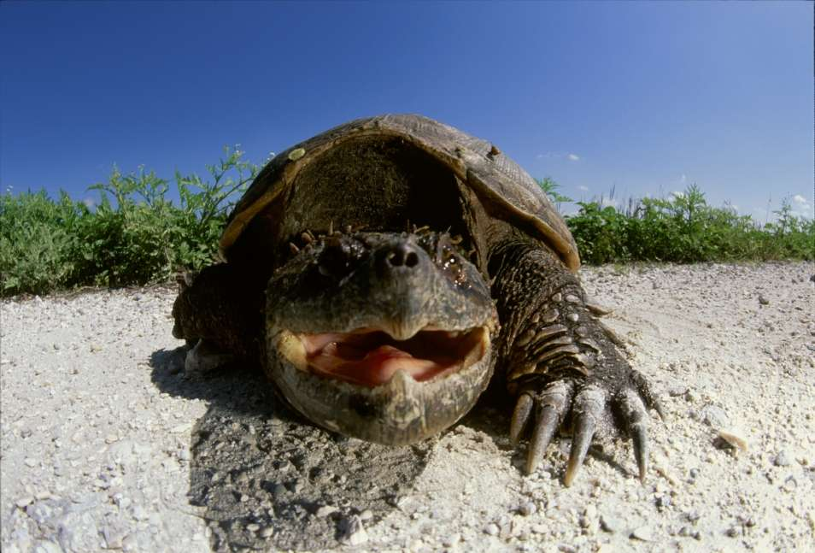
Common Snapping Turtle
(Chelydra serpentina)
Class: Reptilia (reptiles)
Order: Testudines (turtles & tortoises)
Family: Chelydridae (snapping turtles)
Habitat: Aquatic (ponds, lakes, streams, estuaries)
Diet: Omnivore (invertebrates, fish, frogs, reptiles, birds, mammals, aquatic plants)
Comments: Snapping turtles are famous for the speed and power with which they can grab their prey (or a finger). A related species, the alligator snapping turtle (Macrochelys temminckii) lures animal prey near its powerful jaws with a worm-like projection on its tongue. Common snappers can reach 75 lbs, while alligator snappers can grow in excess of 200 lbs!
K-1 match
Track Key
Track ID Guide

Slide 55
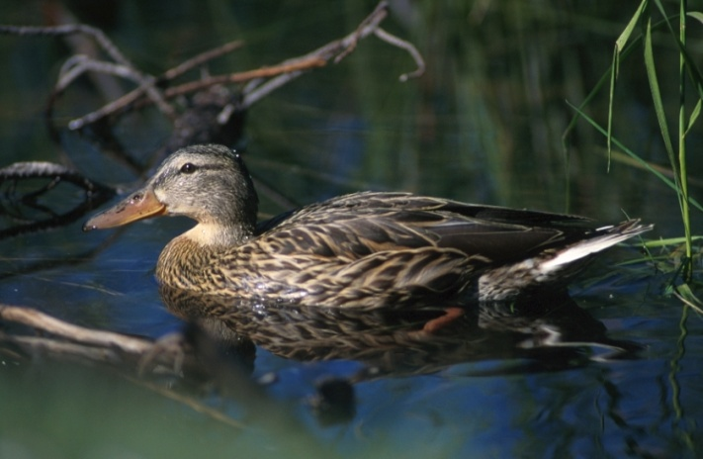
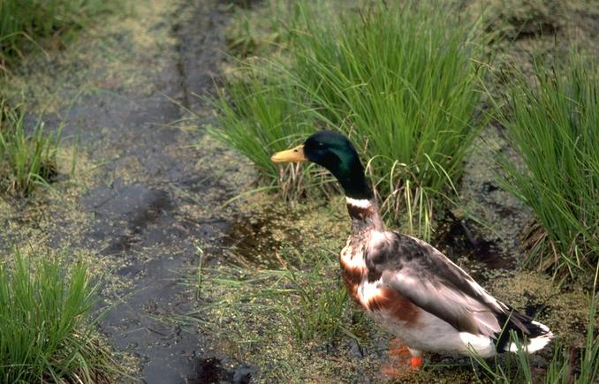
Mallard
(Anas platyrhynchos)
Class: Aves (birds)
Order: Anseriformes (waterfowl)
Family: Anatidae (ducks, geese, & swans)
Habitat: Semi-aquatic (wetlands - near ponds/lakes; riparian areas - near rivers & streams)
Diet: omnivore (aquatic plants, seeds, snails, insects, frogs)
Comments: Well-adapted to living around humans. Like many birds, males are brightly colored to attract mates, & females are more camouflaged. Females typically lay 8-13 eggs during nesting season. Ducklings can immediately swim & catch food on their own, but typically remain with mom for protection.
Female
Male
K-1 match
Track Key
Track ID Guide

Slide 56
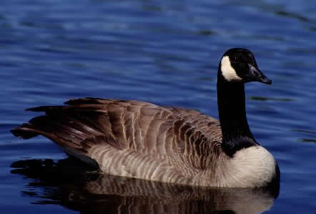
Canada Goose
(Branta canadensis)
Class: Aves (birds)
Order: Anseriformes (waterfowl)
Family: Anatidae (ducks, geese, & swans)
Habitat: Semi-aquatic (wetlands - near ponds/lakes; riparian areas - near rivers & streams)
Diet: Herbivore/slightly omnivorous (mostly grass & grains, but occasionally take insects or small fish)
Comments: This migratory bird is commonly seen along North American waterways. They are easily recognized not only by their distinctive black and white heads, but also by their loud honking calls.
K-1 match
Track Key
Track ID Guide
Scat Key
Scat ID Guide

Slide 57
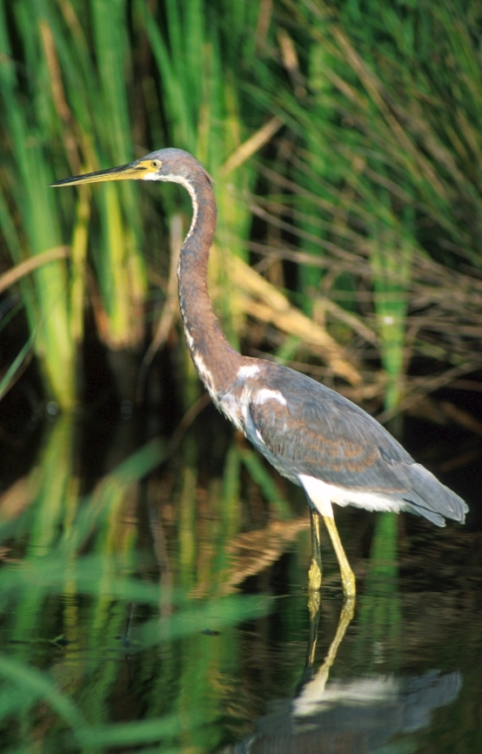
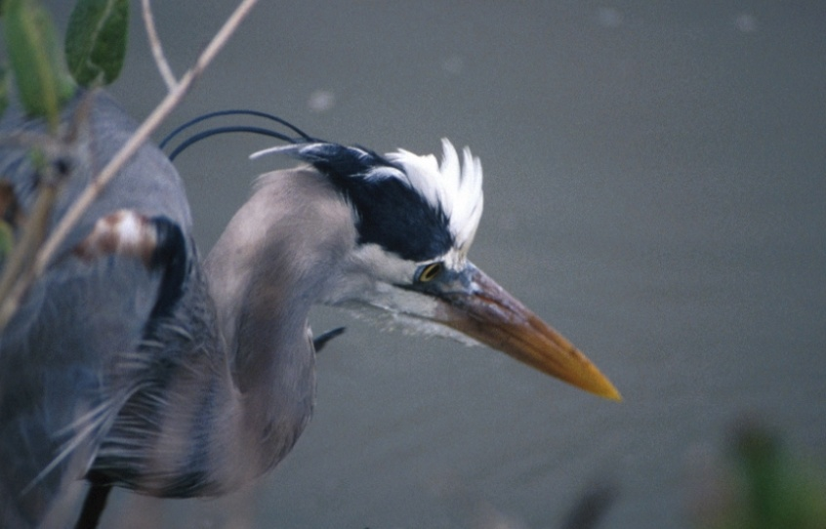
Great Blue Heron
(Ardea herodias)
Class: Aves (birds)
Order: Ciconiiformes (wading birds)
Family: Ardeidae (herons)
Habitat: Semi-aquatic (wetlands - near ponds/lakes; riparian areas - near rivers & streams)
Diet: Carnivore (small fish, but also amphibians, reptiles, small birds, mammals, & aquatic invertebrates)
Comments: These tall wading birds usually forage while standing in water. When they spot prey, they lean forward, arching their long necks before quickly grabbing the prey with their sharp, slender beaks. Though they typically hunt alone, they nest in large, noisy colonies of 50-500 individuals.
K-1 match
Track Key
Track ID Guide

Slide 58
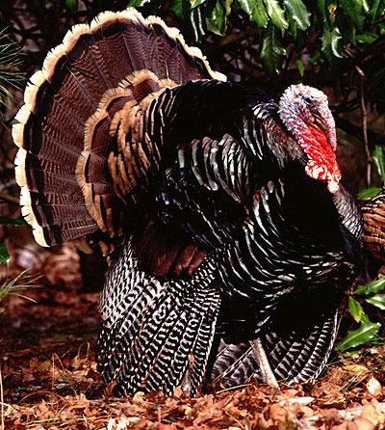
Wild Turkey
(Meleagris gallopavo)
Class: Aves (birds)
Order: Galliformes (gamefowl)
Family: Phasianidae (pheasants, partridges, chickens, turkeys)
Habitat: Terrestrial (deciduous & mixed forests, forest edges, agricultural areas)
Diet: Omnivore (grasses, leaves, roots, seeds, fruits, insects, spiders, snails, small amphibians)
Comments: Male turkeys ("toms") can be distinguished from females by the presence of a long fleshy wattle that hangs from the beak, as well as a "beard" of feathers on the chest. Though they may look clumsy, Wild Turkeys can fly up to 89 km/hr (55 mph) in short bursts!
K-1 match
Track Key
Track Guide
Scat Key
Scat Guide

Slide 59
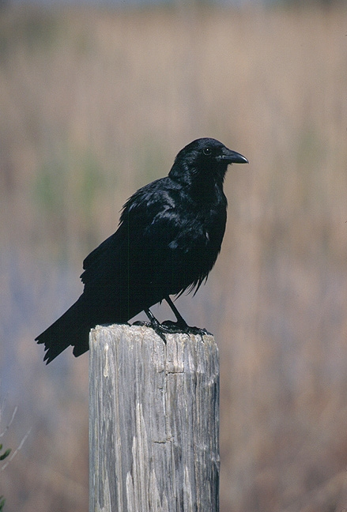
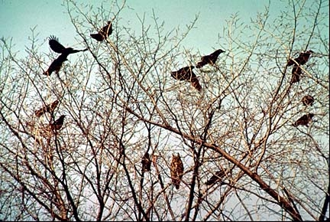
American Crow
(Corvus brachyrhynchos)
Class: Aves (birds)
Order: Passeriformes (perching birds)
Family: Corvidae (crows, ravens, jays, & relatives)
Habitat: Terrestrial/arboreal (forests, open areas, towns & cities)
Diet: Omnivore (invertebrates, dead animals, seeds, bird eggs & hatchlings, fish, grains, mice, frogs, fruits & nuts)
Comments: These intelligent birds are often attracted to shiny objects that they put in their nests. They often mimic the vocalizations of other birds & animals. Crows were once incorrectly assumed to judge & kill flock members that misbehaved. For this reason, a group of crows became known as a "murder."
K-1 match
Track Key
Track ID Guide

Slide 60

Elk (Cervus canadensis)
Class: Mammalia (mammals)
Order: Artiodactyla (even-toed ungulates)
Family: Cervidae (deer & relatives)
Habitat: Terrestrial (forests & forest edges)
Diet: Herbivore (grasses, plants, leaves, and bark)
Comments: The elk is one of the largest species of deer in the world, and one of North America's largest mammals. The Eastern elk, a subspecies once found in Tennessee, is now extinct, but reintroduction of a related subspecies by conservation groups has been fairly successful in restoring these large herbivores to forests in the Appalachian region.
K-1 match
Track Key
Track ID Guide
Scat Key
Scat ID Guide

Slide 61


White-Tailed Deer
(Odocoileus virginianus)
Class: Mammalia (mammals)
Order: Artiodactyla (even-toed ungulates)
Family: Cervidae (deer & relatives)
Habitat: Terrestrial (forests & grasslands)
Diet: Herbivore (twigs, leaves, acorns, grasses, fruit)
Comments: Deer are shy, and are usually seen at dusk or early morning. The males have antlers, and fight with each other to keep a harem of females. The white "flag" on the underside of the white-tailed deer's tail is used to communicate an alarm signal to other deer when a predator has been sighted, to help groups of deer stay together, and to let a predator know that it has been spotted.
Adult Male
Fawn
K-1 match
Track Key
Track ID Guide
Scat Key
Scat ID Guide

Slide 62

Coyote (Canis latrans)
Class: Mammalia (mammals)
Order: Carnivora (carnivores)
Family: Canidae (dogs & their relatives)
Habitat: Terrestrial (many various habitats all over North America)
Diet: Carnivore (small mammals, birds, reptiles, deer, insects, carrion)
Comments: Though they often catch & consume smaller prey on their own, coyotes hunt larger prey (such as deer & elk) in packs, and have been documented to pursue such prey for up to 21 hours, typically covering an average of 4 km (2.5 miles) during a night's hunt.
K-1 match
Scat Key
Scat ID Guide

Slide 63

Red Fox (Vulpes vulpes)
Class: Mammalia (mammals)
Order: Carnivora (carnivores)
Family: Canidae (dogs & their relatives)
Habitat: Terrestrial (found in a variety of habitats, from forests to marshes to tundras)
Diet: Omnivore (invertebrates, fruits, rodents, rabbits, birds, eggs, amphibians, reptiles, & fish)
Comments: Red foxes actually come in a variety of colors, and some change fur color in the winter. They have been hunted for their fur, and are often regarded as pests (though they rarely hunt livestock). In fact, in Japan, they are revered for preying on rodents and insects that destroy crops.
K-1 match
Track Key
Track ID Guide

Slide 64


Mountain Lion or Cougar
(Puma concolor)
Class: Mammalia (mammals)
Order: Carnivora (carnivores)
Family: Felidae (cats)
Habitat: Terrestrial (woodlands, rainforests, deserts)
Diet: Carnivore (deer are their most important prey, but they also eat other mammals, birds, & insects)
Comments: These large cats are important predators in many food chains. They are rarely seen, as they are shy and avoid people. They are thought to have been extirpated from most of the U.S., with the exception of Florida, but many reports have been submitted throughout the eastern states.
K-1 match
Track Key
Track ID Guide

Slide 65

Striped Skunk
(Mephitis mephitis)
Class: Mammalia (mammals)
Order: Carnivora (carnivores)
Family: Mephitidae (skunks)
Habitat: Terrestrial (forests, fields, & urban areas)
Diet: Omnivore (eggs, mice, berries, grubs)
Comments: Skunks are best known for their ability to spray a foul-smelling secretion from their anal glands. This chemical defense is highly effective at deterring predators, and has even been known to drive away bears. Skunks can spray this compound with a great degree of accuracy up to about 5 m (15 feet)!
K-1 match
Track Key
Track ID Guide
Scat Key
Scat ID Guide

Slide 66


River Otter
(Lontra canadensis)
Class: Mammalia (mammals)
Order: Carnivora (carnivores)
Family: Mustelidae (weasels & their relatives)
Habitat: Aquatic/Semiaquatic (wetlands - near ponds/lakes; riparian areas - near rivers & streams)
Diet: Carnivore (fish, frogs, crayfish)
Comments: Highly intelligent and playful, these relatives of weasels are active during the day. They build dens along riverbanks, and are excellent swimmers. They are capable of diving up to 17 m (55 feet), and swimming as far as 0.4 km (0.25 miles) underwater. Both of these skill come in handy for catching their aquatic prey.
K-1 match
Track Key
Track ID Guide

Slide 67

Mink
(Mustela vison)
Class: Mammalia (mammals)
Order: Carnivora (carnivores)
Family: Mustelidae (weasels & their relatives)
Habitat: Semiaquatic (wetlands - near ponds/lakes; riparian areas - near rivers & streams)
Diet: Carnivore (muskrats & other rodents, frogs, fish, birds, & snakes)
Comments: Minks are well known for their fine fur. In the wild, they are territorial and aggressive. They are ferocious hunters, often attacking prey their own size or even larger. They are also good swimmers, which helps them efficiently catch their often aquatic prey.
K-1 match
Track Key
Track ID Guide

Slide 68

Raccoon
(Procyon lotor)
Class: Mammalia (mammals)
Order: Carnivora (carnivores)
Family: Procyonidae (raccoons, coatis, ringtails, & relatives)
Habitat: Terrestrial/Arboreal (deciduous & mixed forests, agricultural areas, & occasionally cities)
Diet: Omnivore (fruit, berries, grains, eggs, poultry, vegetables, nuts, molluscs, fish, insects, rodents)
Comments: Due to the markings around their eyes, raccoons are often referred to as "masked bandits." Raccoons are nocturnal, & sometimes steal their dinners from garbage containers in urban areas. They do best in forested areas, however, as they depend heavily on trees to climb when they feel threatened.
K-1 match
Track Key
Track ID Guide

Slide 69

Little Brown Bat
(Myotis lucifugus)
Class: Mammalia (mammals)
Order: Chiroptera (bats)
Family: Vespertilionidae (common bats/vesper bats)
Habitat: Terrestrial/Arboreal (hollow trees, attics, barns, & caves)
Diet: Insectivore (mostly insects with an aquatic life stage, such as mosquitoes)
Comments: Little Brown Bats catch insects with their wingtips, then scoop them into a pouch formed by their tails, and eat them in flight. Like many bats in the eastern U.S., Little Brown Bat populations are declining due to white nose syndrome, a fungal disease that kills bats. The fungus can clearly be seen on the bat in the image.
K-1 match
Track Key
Track Guide
Scat Key
Scat Guide

Slide 70


Virginia Opossum
(Didelphis virginiana)
Class: Mammalia (mammals)
Order: Didelphimorphia (New World opossums)
Family: Didelphidae (New World opossums)
Habitat: Arboreal/Terrestrial (forests, open woods, rural & urban areas)
Diet: Omnivore (fruit, nuts, dead animals, insects, birds, small animals)
Comments: The Virginia Opossum is North America's only marsupial (animals in which the mother carries the babies in a pouch). They may act dead ("play possum") when threatened, though they may also show their teeth and hiss loudly. Their prehensile tails assist them in climbing, and are sometimes used to carry small objects.
K-1 match
Track Key
Track ID Guide

Slide 71

Eastern Cottontail
(Sylvilagus floridanus)
Class: Mammalia (mammals)
Order: Lagomorpha (rabbits, hares, & pikas)
Family: Leporidae (rabbits & hares)
Habitat: Terrestrial (prefer brushy areas)
Diet: Herbivore (vegetation, twigs, & bark)
Comments: Rabbits are typically active during evening and early morning, and take shelter in burrows & brush piles. Females can have up to four litters of 4-7 young per year. Lagomorphs (and some rodents) produce two kinds of poop. They typically eat the softer form (known as cecotropes) to extract all possible nutrients from their hard-to-digest herbaceous diet.
K-1 match
Track Key
Track ID Guide
Scat Key

Slide 72


Muskrat
(Ondatra zibethicus)
Class: Mammalia (mammals)
Order: Rodentia (rodents)
Family: Cricetidae (hamsters, voles, lemmings, New World rats & mice)
Habitat: Semi-aquatic (wetlands - near ponds/lakes, riparian areas - near rivers/streams)
Diet: Herbivore (aquatic vegetation)
Comments: Muskrats have webbed hind feet, and are strong swimmers. Like beavers, they build houses with underwater entrances out of sticks. They are active at night (nocturnal), but also near dawn and dusk (crepuscular). Muskrats are important prey for many predatory mammals, birds, & reptiles.
K-1 match
Track Key
Track ID Guide

Slide 73

Eastern Grey Squirrel
(Sciurus carolinensis)
Class: Mammalia (mammals)
Order: Rodentia (rodents)
Family: Sciuridae (tree, ground, & flying squirrels; chipmunks, marmots, & prairie dogs)
Habitat: Arboreal/Terrestrial (forests, rural & urban areas)
Diet: Herbivore (mostly nuts & seeds)
Comments: Grey squirrels are most commonly seen foraging for nuts on the ground. They cache (store) food for the winter either in their home trees, or buried nearby in scattered locations. Like many squirrels, they communicate with other squirrels with a complex system of vocalizations & posturing, including flicks of their fluffy tails.
K-1 match
Track Key
Track ID Guide

Slide 74

Eastern Chipmunk
(Tamias striatus)
Class: Mammalia (mammals)
Order: Rodentia (rodents)
Family: Sciuridae (tree, ground, & flying squirrels; chipmunks, marmots, & prairie dogs)
Habitat: Terrestrial (forests, brushy areas, rural & urban gardens & lawns)
Diet: Mostly herbivorous (seeds, fruits, nuts), but also consumes some insects
Comments: These small mammals live in underground burrows where they store food. They are most active and breed in warm months, and sleep through most of the winter (hibernate).
K-1 match
Track Key
Track ID Guide

Slide 75
Exercise 1e. How fast was that dinosaur moving?
As mentioned earlier, one can learn many things about an animal from its tracks.
This includes how fast the animal was moving when it made them.
In this exercise, you will learn how this can be done, using a little bit of math.
In order to do this, first, you will learn a little bit more about types of data, data analysis, and biomechanics, which is the science of movement of a living body.
To complete this exercise, you will need to understand metric measurement. For further explanation on metric measurements, click HERE. Otherwise, click HERE to move on.
75

Slide 76
Exercise 1e. How fast was that dinosaur moving?
The metric system is based on multiples of ten.
If you look at your metric ruler or meter stick, you will see the very smallest units marked on the edge of the ruler.
Those very small units are millimeters. The prefix milli- tells you that each of those small sections represents 1/1000 of a meter (0.001), meaning there are 1000 millimeters in a meter.
Ten of those very small sections (millimeters) represents one centimeter. The prefix centi- tells you that length represents 1/100 (0.01) of a meter, which means there are 100 centimeters in a meter. If there are ten millimeters in every centimeter, and you have a length of 100 centimeters, you then have one meter.
10mm = 1cm
100cm = 1m
1000mm = 1m
76

Slide 77
Exercise 1e. How fast was that dinosaur moving?
Look at the metric ruler below.
The smallest spaces marked on the ruler represent millimeters, and the numbers you see on the ruler represent centimeters.
If you count the number of those very small spaces between the numbers, you will see there are ten spaces, or millimeters, in each centimeter. (Be sure and count the spaces, not just the lines drawn between the spaces.)
If you are measuring a length in centimeters and you find the length to be 4 small spaces after the number 5 on the ruler, then you have 5 whole centimeters and 4/10 of another (or 4 millimeters). This is written 5.4cm (read five and four tenths centimeters).
Always use decimal numbers when using the metric system and always label your lengths with the appropriate units.
77

Slide 78
Exercise 1e. How fast was that dinosaur moving?
You will be finding lengths in this exercise that call for you to measure in meters.
Since there are 100 centimeters in one meter, you will need to know how to write your measurements to indicate meters.
If you measure a length to be 2 whole meters with an additional 9 centimeters, that means your length is 2.09 meters ( 2 whole meters plus 9/100 of another meter since one centimeter is equal to 1/100 of a meter).
If you measure a length of 5 whole meters and 24 additional centimeters, your length will be written 5.24 (5 whole meters plus 24/100 of another meter).
78

Slide 79
Exercise 1e. How fast was that dinosaur moving?
Let’s say you measure a length of 4 meters plus 18 centimeters plus 3 millimeters. How would you write this in decimal form as units of meters?
Since you know that there are 10 millimeters in every centimeter, multiply 18 x 10 to get 180, which tells you there are 180 millimeters in 18 centimeters.
Add the three additional millimeters to 180 for a sum of 183 millimeters.
You know that one millimeter is 1/1000 of a meter, so that means 183 millimeters is 183/1000 of a meter, or 0.183.
Your length will be 4.183 (4 whole meters, and 183 thousandths of another meter).
79

Slide 80
Exercise 1e. How fast was that dinosaur moving?
The term data is probably one that you have heard often in scientific contexts.
Simply stated, data are facts or measurements.
Note, the word “data” is plural (the singular is “datum”, which refers to a single measurement or data point in a data set).
You are probably already familiar with univariate data, which are measurements of a single trait (from different individuals, at different time periods from the same individual, etc).
In this exercise, you will be working with bivariate data, which are measurements of two traits or variables.
Scientists also often work with data involving more than two measured traits/variables. Such data is referred to as multivariate data.
80

Slide 81
Exercise 1e. How fast was that dinosaur moving?
Often in working with bivariate data, scatter plots are used to visualize possible relationships between the two measured traits. These plots are called scatter plots because they show points in a way that sometimes looks as if they have been scattered about the graph.
In a scatter plot, one trait is plotted along the x-axis, and one trait is plotted along the y-axis, with each data point representing the measurements of both traits for a given individual.
For example, examine the set of bivariate data below, which consists of measurements of foot length and leg length.
Now examine a scatter plot constructed from these data.
 | Foot length (cm) | Leg length (cm)
1 | 17.8 | 83.6
2 | 25.4 | 101.6
3 | 22.9 | 89.7
Leg length (cm)
81
Foot length (cm)

Slide 82
Exercise 1e. How fast was that dinosaur moving?
Leg length (cm)
Leg length (cm)
Foot length (cm)
Foot length (cm)
Scientists are often interested in whether two traits in bivariate data are correlated, or change together in a particular way.
Notice in the example above, as foot length increases, so does leg length. In this case, then, these traits are positively correlated.
If one variable decreases when another increases, those variables are said to be negatively correlated.
One can also add a best fit line to a plot of bivariate data.
A best fit line is a line passing as closely to all data points as possible.
82

Slide 83
Exercise 1e. How fast was that dinosaur moving?
Leg length (cm)
Foot length (cm)
In a particular scatter plot, if most of the points fall very close to the best fit line, the two traits in question are said to have a linear relationship.
In the figure above at the left, does it appear that foot length and leg length have a linear relationship?
Why do you think this relationship might be observed?
What about the figure on the right? Does it appear that Variable 1 and Variable 2 show a linear relationship?
Why or why not?
83

Slide 84
Exercise 1e. How fast was that dinosaur moving?
If you can draw a line through your plot that projects through the middle of the set of points and as close to the ‘center’ of the set of points as possible, then you can say the graph indicates a linear relationship.
The line is called the best fit line because it fits as closely as possible to the complete data set even though it cannot project through each individual point.
Observe the best fit line added to the data points below.
Leg length (cm)
Foot length (cm)
84

Slide 85
Exercise 1e. How fast was that dinosaur moving?
Even though the line does not project through all the points, it does show the trend represented by the data points.
The line is very close to all the points. The best fit line allows you to detect the trend in your data and to predict what additional data might show if you were to collect more data for the same exercise.
The closer the points on the plot are to each other, the more likely it will be to predict trends in the data.
The further apart your points are on your plot, or if they are scattered about the plot with no obvious trend, the likelihood of being able to use the data to make any kind of predictions is extremely limited.
Leg length (cm)
85
Foot length (cm)

Slide 86
Exercise 1e. How fast was that dinosaur moving?
Now let’s think about biomechanics, and what data might be useful to us when trying to figure out how fast an animal was moving, based on its tracks.
Naturally, most animals move around using their legs and feet.
Therefore, some measurement of an animal’s legs or feet might come in handy.
There are several different characteristics of an animal’s feet/legs that we can measure, either directly, or from their tracks.
The next slide presents a few of these measurements.
86

Slide 87

Exercise 1e. How fast was that dinosaur moving?
Stride length is the distance from heel to heel (or toe to toe) on consecutive tracks made by the same foot.
Track length is a good approximator of foot length, and is just measured from the rearmost to forwardmost point of a track, along the direction of movement.
Leg length is measured as the distance between an animal’s hip joint and the base of the foot.
87

Slide 88
Exercise 1e. How fast was that dinosaur moving?
Remember, we are interested in estimating an animal’s speed from its tracks.
Speed is just a measure of distance traveled divided by the time it took to travel that distance. Expressed mathematically,
speed = distance/time
Scientists usually use metric units for measuring many things, so in this exercise, you should do the same.
  All measurements of length or distance in this exercise should be done in (or later converted to) meters.
  Measurements of time will be done in seconds.
88

Slide 89

Exercise 1e. How fast was that dinosaur moving?
In this exercise, you will also be calculating a value for dimensionless speed, for reasons which will become clear later.
Dimensionless speed is calculated as the speed divided by the square root of the product of leg length and the gravitational constant, which is equal to 9.81 meters per second squared.
Expressed mathematically, the equation for calculating dimensionless speed looks like the formula below.
Look carefully at the formula for dimensionless speed.
Why do you think it is called “dimensionless”?
89

Slide 90

Exercise 1e. How fast was that dinosaur moving?
You might be wondering how all this ties together in determining an animal’s speed from its tracks.
Below is a scatter plot reproduced from a study by R. McNeill Alexander, at the University of Leeds in England, in which he plotted relative stride length (which is equal to stride length divided by leg length) against dimensionless speed.
Does this relationship appear to be linear?
Do relative stride length and dimensionless speed appear to be positively or negatively correlated?
Make a general statement relating these two variables, and try to think about this relationship
in a biological context. Why does
this make sense?
90

Slide 91
Exercise 1e. How fast was that dinosaur moving?
In this exercise, you will duplicate Alexander’s experiment, using yourself and other students as subjects on which you will collect data on
  Leg length
  Stride length
  Speed
For each student, the above data will be calculated at two different speeds: walking & running.
From these measurements, you will calculate other important values that we have already mentioned to help you construct a scatter plot similar to Alexander’s.
You will also use your plot to help you calculate the speeds at which animals (including dinosaurs!) were moving when they made their tracks.
91

Slide 92
Directions for Exercise 1e.
Divide into teams of 3-4 students each.
Measure the length of each student’s leg, from the hip joint to the base of the shoe.
Record each student’s leg length in a data table that has leg length as a column, and the name of each individual as each row.
For each trial, one student on a team will be the timer, a second student will be the traveler, and the third or fourth student will mark the ending point of the distance traveled.
Place a piece of tape at one end of the hallway, track, or open space in the classroom.
At the beginning of the trial, the traveler stands in a ready position, with his or her front heel just touching the starting tape.
92

Slide 93
Exercise 1e. How fast was that dinosaur moving?
When the timer says “go,” the traveler should take six walking steps and stop, holding his or her position. Simultaneously, the timer should stop the stopwatch just as the traveler’s foot hits the ground on his/her sixth step.
The marker places a piece of tape at the back of the heel of the traveler’s front foot.
Measure the distance from the starting tape to the finish tape in meters.
Record this distance in a second column labeled ‘Distance Traveled’, which you have added to your data table.
Also record the time it took the traveler to complete their six steps in a third column labeled “Walk Time” (again, this should be in the same row as the other measurements collected for that traveler).
Repeat steps 7-11 until every student in the group has been the traveler.
93

Slide 94

Exercise 1e. How fast was that dinosaur moving?
To your tables, add columns labeled “Stride Length”, “Relative Stride Length”, “Speed”, and “Dimensionless Speed”. An example table, including how to calculate values for each of these columns, is provided below.
After the entire class has had a chance to complete their measurements, the teacher will collect the data from all groups, and share it with the class.
Alternatively, the teacher may construct a table on the board for each group to fill in as they complete their measurements.
94

Slide 95
Linear Equations
Construct a scatter plot of the entire class’s data, plotting walking and running speeds on the same plot.
Plot dimensionless speed on the x-axis, and relative stride length on the y-axis.
Draw a line through your data points so that as many points are as close to your line as possible.
The line you have drawn is described by a linear equation of the form
y = mx + b
In linear equations, x and y are the variables you measured.
The variable m refers to the slope of the line.
The variable b refers to the y-intercept of the line.
We will learn a little more about what these terms tell us on the next few slides.
95

Slide 96
Linear Equations
Rate is way of expressing how something is changing. For example, the gas mileage of a car is indicated by miles per gallon, and a worker’s pay is expressed in dollars per hour.
In each of those examples, the rates include two different units: miles per gallon and dollars per hour. The two units tell how one unit, or variable, changes as the other variable changes. The more miles you drive, the more gas your car uses. You are paid more if you work more hours.
When we graph a comparison of variables (dollars per hour, for example), we often want to see how one variable is changing as the other variable changes.
This rate of change is also called the slope because, when the data are graphed, we look to see the trend of points on the graph.
Think of the word slope and how you use it. A hill slopes upward or downward, and can be either steep or subtle, and that is what slope describes in graphs: the way the variables relate to one another, in terms of how one changes with the other.
96

Slide 97
What can slopes tell us?
Why are slopes of lines of interest to us?
Look at the figure below, and examine the equations that describe the best fit lines for the relationships between x, Trait 1, and Trait 2.
The positive slope on the line for Trait 1 shows us that x and Trait 1 are positively correlated.
The negative slope of the line for Trait 2 shows us that x and Trait 2 are negatively correlated.
97

Slide 98
What can slopes tell us?
What can slopes tell us if slopes of two lines are of the same sign, but differ in magnitude? Examine the figure below:
The lines for both traits have positive slopes.
Again, remember, this means that both traits 3 & 4 increase as x increases.
However, the greater positive slope of the line for Trait 4 tells us that, though both Trait 3 and Trait 4 increase with x, Trait 4 increases more quickly as x increases!
98

Slide 99
Calculating the slope of a line
To calculate the slope of a line, one can use another form of the equation for a line, known as the point-slope form.
From its name, you can probably guess that this formula expresses a line in terms of a point on the line and the slope of the line. The point-slope formula for a line is
m = (y₂ – y₁)/(x₂ – x₁)
where again, m represents the slope of the line, and (x₁, y₁) and (x₂, y₂) are two points on the line.
Look at the best fit line you have drawn through the class’s data.
Pick two points on that line (these do not have to be data points, just points on your best fit line), and calculate the slope of your best fit line.
99

Slide 100
Calculating the slope of a line
Now that you know the slope of your best fit line, you should determine the slope-intercept form of this line.
There are several ways you could do this, but one way would be the following:
Pick a point on your line. Note the x and y coordinates of that point.
Look at the slope-intercept formula for a line (y = mx + b).
Substitute your values of x, y, and m (which you just calculated) to solve for the b (the y-intercept) of your best fit line.
The equation of Alexander’s best fit line is approximately equal to y = 1.1x + 1
Is the equation of your best fit line similar?
If not, can you think of some reasons why it might be different from Alexander’s equation?
100

Slide 101
Calculating the slope of a line
Now that you know the slope of your best fit line, you should determine the slope-intercept form of this line.
There are several ways you could do this, but one way would be the following:
Pick a point on your line. Note the x and y coordinates of that point.
Look at the slope-intercept formula for a line (y = mx + b).
Substitute your values of x, y, and m (which you just calculated) to solve for the b (the y-intercept) of your best fit line.
The equation of Alexander’s best fit line is approximately equal to y = 1.1x + 1. Rearrange this to solve for dimensionless speed (x) in terms of relative stride length (y)
Is the equation of your best fit line similar?
If not, can you think of some reasons why it might be different from Alexander’s equation?
101

Slide 102

Putting your knowledge to work!
To the right are some images of two types of dinosaurs, and tracks that they made.
Your teacher may provide you with a copy of this image.
On your paper copy, the tracks are 1/50th actual size.
Measure the dinosaur’s tracks and stride lengths.
In general, dinosaur’s legs were approximately 4 times the length of their hind feet.
SL = stride length
TL = track length
l = left, r = right
m = manus (“hand”/front foot)
p = pes (hind foot)
102

Slide 103
Putting your knowledge to work!
Using the information you obtained from measurements of the scaled images of the dinosaur tracks, estimate the speeds at which each dinosaur was traveling
  using the equation of your best fit line for your data
  using Alexander’s equation.
Are your estimates using your data similar to those calculated using Alexander’s equation?
If not, why do you think they might be different?
Alternate Open-ended Exploration
Look for tracks in your own backyard or nearby, or find images of animal tracks (with some sense of scale) online.
Do some internet research on the average leg length of the animal that made the tracks.
See if you can figure out how fast that animal was moving!
103

Slide 104
Exercise 2. The Scoop on Poop!
Some of the most common signs that can tell us what animals are in an area are the tracks they leave behind.
However, sometimes they leave other signs like feces, (droppings, poop, or scat).
Naturalists and animal trackers call animal feces 'scat', and scientists who study animal feces are called 'scatologists'.
It may seem strange to study animal poop, but there is an amazing amount of information that can be learned from it.
104

Slide 105
Exercise 2. The Scoop on Poop!
From a pile of droppings we can learn:
1) What kind of animal left the poop.
2) How big an area the animal is using.
3) What the animal is eating.
4) How healthy the animal is.
5) We can even get DNA from poop and identify how many families are in an area and how spread out (dispersed) family members are!
105

Slide 106
Objective
Exercise 2 gives students a chance to investigate characteristics that differ among animal species in the feces (poop) they produce.
Students will learn
  Characteristics of scats of animals of varying
    Size
    Diet type
    Taxonomic orders & classes
106

Slide 107
Identifying scat is not as easy as identifying animal tracks because it is more variable. No two scats are exactly alike, and an individual's scat can change based on what or how much it is eating. There are, however, some key characteristics of different types of animal poop.
Herbivores (animals which eat grass and other plant material) generally leave very smooth and rounded pellet-like scat.
Carnivores (animals that eat other animals) often have hair or feathers in their scat because these are not digested.
Birds have some amount of white material mixed with the poop (This is because their urine has less water than other animals and is excreted as uric acid).
Omnivores (animals which eat a mixed diet) often have undigested seeds in their scat, which can even sprout and grow! Since omnivores also eat animals, as well, there may also be hair in their scat, as also seen in carnivores.
Insectivores (animals which eat insects) usually have small, rough, and irregular-shaped pellets.
Click HERE to go back to Exercise 2c (Grouping Scats by Animal Diet) if you came from there. Otherwise, click anywhere else to move on.
107

Slide 108
Exercise 2: The Scoop on Poop
Note: In these exercises you will be
looking at real animal scat
learning what animals made them
figuring out information about the animals from it.
Don’t worry – the scat is completely clean and safe. The poop is first dried, then coated in plastic and then sealed in a plastic container. Nevertheless, please do not try to open the boxes!
108

Slide 109
Exercise 2: The Scoop on Poop
Materials:
All of the scat samples
Backyard Naturalist Guide to Animal Scats (in the book for this unit)
  This is optional, as this information can also be found in this PowerPoint presentation
Click one of the underlined exercises below to go to the grade-level appropriate exercise:
Exercise 2a. Matching the Poop with the Pooper (Grades K-1)
Exercise 2b. Using a key to identify animal scat (Grades 2-12)
Exercise 2c. Grouping Animal Scats by Diet (Grades 2-12)
109

Slide 110
Exercise 2a. Matching the Poop with the Pooper
The teacher will spread the scat samples out on a table, and display the next slide showing a series of animals.
Have the students look at the first animal picture and raise their hands if they know what the animal is.
Select one to name the animal and take a class vote on whether this is correct or not.
If correct, invite the student to come to the front table to find the scat sample that matches the picture of the poop next to the animal that made it.
If this student has chosen the correct scat, pass the sample around so that all students have a chance to look at it. Discuss what type of diet this animal has based on the characteristics of its poop.
If the student has chosen an incorrect sample, invite another volunteer to make a choice.
Repeat until all scats have been identified.
110

Slide 111








Click to show an animal, again to see the ID of the animal.
Click again to see a picture of the animal’s scat, & again for the letter of the scat sample that correctly matches the animal.
Click animal pictures for info!
White-tailed Deer
A
Canada Goose
E
F
Coyote
Little Brown Bat
D
111

Slide 112








Click to show an animal, again to see the ID of the animal.
Click again to see a picture of the animal’s scat, & again for the letter of the scat sample that correctly matches the animal.
Click animal pictures for info!
Elk
B
Striped Skunk
G
Wild Turkey
C
Eastern Cottontail
H
112

Slide 113
Exercise 2b. Using a Key to Identify Animal Scat
Materials:
All of the scat samples
Scat identification key
Directions:
Using the information you learned about dichotomous keys in Exercise 1c (Key Those Tracks), and the key to animal scats on the next slides, key out each of the provided animal scats from this unit.
To review this information, click HERE.
At the end of the key is a link to check your answers!
113

Slide 114
The Backyard Naturalist Key to Animal Scats
1a. Scat is made up of smooth rounded pellets……..Go to 2
1b. Scat not made up of smooth rounded pellets…...Go to 3
2a. Scat pellets oblong…………………………………...Go to 4
2b. Scat pellets nearly spherical………….Eastern Cottontail
3a. Scat has a patch of white material………………...Go to 5
3b. Scat has no patch of white material……………….Go to 6
4a. Scat pellets are larger than 1.5 cm……………………..Elk
4b. Scat pellets are smaller than 1.5 cm….White-tailed Deer
114
Continued

Slide 115
The Backyard Naturalist Key to Animal Scats
5a. Scat is like pebbles 1-3 cm in size……….…Wild Turkey
5b. Scat sausage-shaped, grassy texture…..Canada Goose
6a. Scat irregular pellets < 1 cm…................Little Brown Bat
6b. Scat is larger than 1 cm……………………………..Go to 7
7a. Scat contains animal hair….………………………Coyote
7b. Scat contains seeds……………………….Striped Skunk
Time to check your answers!!!
Go to the next slide to see how many you got right.
115

Slide 116
Backyard Naturalist Scat Identification Guide
Click the image of a scat below to find out what animal made the track!
Click the button for the “Scat ID Guide” on each animal page to come back to this guide!
A
B
C
D
E
F
G
H
116

Slide 117
Exercise 2c. Grouping Scats by Diet Type
Think about the descriptions of scats of animals of various diet types. Click HERE to review.
Try to determine the diet types of all the animals represented by your scat samples.
Do not click again until you are ready to check your answers!
Herbivores: White-tailed deer (A), Elk (B), Rabbit (H)
Carnivore: Coyote (F)
Omnivore: Striped Skunk (G)
Insectivore: Little Brown Bat (D)
Birds: Wild Turkey (C), Canada Goose (E)
117

Slide 118
Exercise 3. Getting to Know the Animals
This is the class-wide version of a game to test students’ naturalist knowledge!
For an alternate version that students can play in groups, see the workbook for this unit!
Spread the tracks and scats out at the front of the room.
Take one of the decks of game cards and shuffle it.
Take a card and read the information on it aloud to the class.
Select a student to choose a track or scat belonging to an animal that matches the description of it (some cards have more than one correct answer!).
The student should tell the class what track or scat they chose to match the information on the card, and pass the scat or track around for other students to examine.
The class should vote on whether they agree or disagree on the choice of track/scat.
Go to the answer key to check the correct answer, and share it with the class.
Repeat with additional draws from the deck and new volunteers.
118

Slide 119
Exercise 4. Birdsongs & Things That Go Bump in the Night
We humans tend to be visually oriented. But good naturalists learn to use all their senses, including their sense of hearing.
Hearing bird songs is often the best way to identify them because they are frequently hidden up in the trees.
And at night, we can also use our ears to determine just what creatures are making those strange noises in the dark.
It can be spooky outside at night because we can't see well. But if we learn to use the sounds animals make to identify them, it can be fun instead.
In these exercises, we will listen to recordings of different birds and night animals and learn to identify them.
119

Slide 120
Objectives
In these exercises, students will ….
learn to identify common bird species in east Tennessee by the sounds they make.
learn to identify nocturnal animals that are difficult to see by their sounds.
attempt to describe bird sounds visually.
learn about how scientists visualize sounds by depicting them graphically.
120

Slide 121
Exercise 4. Birdsongs & Things That Go Bump in the Night
Click the underlined links below to go to the grade-level appropriate exercises that you want to explore.
Exercise 4a. How many birds do you hear? (Grades K-2)
Exercise 4b. Identifying individual birds (Grades 3-12)
Exercise 4c. Identifying Birds in Groups (Grades K-12)
Exercise 4d. Sounds of the Night (Grades K-12)
Exercise 4e. Visualizing Bird Songs (Grades 7-12)
Exercise 4f. The Science of Sound (Grades 7-12)
121

Slide 122
Exercise 4a How many different birds do you hear?
Materials:
Birdsongs & Things that Go Bump in the Night Audio CD
The Backyard Naturalist Picture Guide to Birds
CD Player
122

Slide 123
Directions
Cue up track 1 on the CD and listen to the instructions.
Pictures of the birds are on the next slide!
Go to track 27.
Listen to the recording of the first group of birds.
How many different kinds of birds did you hear in the track?
Find answer on the next track (28).
Repeat for each of the 7 groups included on the CD (tracks 27- 40).
123

Slide 124

The Backyard Naturalist Picture Guide to Birds
124

Slide 125
Exercise 4b. Identifying Individual Birds
Materials:
Birdsongs & Things that Go Bump in the Night Audio CD
The Backyard Naturalist Picture Guide to Birds
CD Player
Pencil and paper
125

Slide 126
Directions
Listen to track 1 and 2 on the CD.
Listen to track 3 and commit the songs you hear to memory.
Complete the practice quiz found on track 4. Click HERE for images of possible bird species.
Complete the quiz found on track 5.
You have now completed the first session.
Repeat the above steps involving a learning session, a practice quiz and a quiz for sessions 2 (tracks 6-8) and 3 (tracks 9-11). Write down your answers.
BIG CHALLENGE: At the end (track 12), there is a review quiz (Super Solver Quiz) involving all of the bird songs you have learned on this CD.
Do not move on to the next slide until you are ready to check your answers!
126

Slide 127
Answers to Exercise 4b. Identifying Individual Birds
Group 1
Quiz 1 (practice) Quiz 2
1) White-Breasted Nuthatch 1) Wood Thrush
2) American Crow 2) Eastern Wood Pewee
3) Eastern Wood Pewee 3) White-Breasted Nuthatch
4) Wood Thrush 4) Carolina Chickadee
5) Carolina Chickadee 5) American Crow
Group 2
Quiz 1 (practice) Quiz 2
1) Red-Tailed Hawk 1) House Finch
2) American Robin 2) Red-Winged Blackbird
3) House Finch 3) Carolina Wren
4) Carolina Wren 4) American Robin
5) Red-Winged Blackbird 5) Red-Tailed Hawk
127

Slide 128
Answers to Exercise 4b. Identifying Individual Birds
Group 3
Quiz 1(practice) Quiz 2
1) Mourning Dove 1) Northern Mockingbird
2) Downy Woodpecker 2) Blue Jay
3) Northern Cardinal 3) American Goldfinch
4) Northern Mockingbird 4) Downy Woodpecker
5) American Goldfinch 5) Northern Cardinal
6) Blue Jay 6) Mourning Dove
Type Quiz and Super Solver Quiz
1) Mourning Dove
2) Northern Cardinal
3) Eastern Wood Pewee
4) Blue Jay
5) Red-Tailed Hawk
6) Carolina Chickadee
7) Red-Winged Blackbird
8) American Goldfinch
128

Slide 129
Exercise 4c. Identifying birds in groups
Materials:
Birdsongs & Things that Go Bump in the Night Audio CD
The Backyard Naturalist Picture Guide to Birds
CD Player
Pencil and paper
129

Slide 130
Directions for Exercise 4c.
When you feel confident in your ability to identify individual bird songs, see if you can identify the calls of specific bird species from a group of many different bird species calling at the same time.
Find Track 13 on the CD.
This is a recording of a mixed group of bird species calling at the same time.
Write down the names of all the different birds you hear on the track. Again, click HERE for images of all the birds that you could potentially hear in this exercise.
Move to the next track to learn the correct answer.
Repeat these steps for a total of 7 sessions (tracks 13-26).
130

Slide 131
Exercise 4d. Sounds of the Night
Materials:
Birdsongs & Things that Go Bump in the Night Audio CD
The Backyard Naturalist Picture Guide to Birds
CD Player
Pencil and paper
131

Slide 132
Directions for Exercise 4d. Sounds of the Night
Listen to tracks 41-42 on the CD.
Your goal is to learn to identify the calls of the frogs, birds, and insects that call at night. You will also learn to discriminate between the calls made by these three groups of nocturnal animals.
Subsequent tracks contain calls from each of the three groups.
Listen to the frog calls on track 43 until you feel confident that you can discriminate between them.
Complete the two frog call quizzes on tracks 44 & 45.
Repeat this process for night bird calls on tracks 46-48.
Listen to the two insects calls on track 49.
Complete the quiz on discriminating between the calls of the three types of animals on track 51.
Complete the Super Solver Quiz on track 50.
Click HERE for images of each of the night animals.
Click HERE for answers to each of the quizzes.
132

Slide 133

The Backyard Naturalist Picture Guide to Night Animals
133

Slide 134
Answers for Exercise 4d. Sounds of the Night
Answers to Frog Calls Quiz
Quiz 1 Quiz 2
1) Bullfrog 1) Chorus Frog
2) Chorus Frog 2) American Toad
3) American Toad 3) Spring Peeper
4) Spring Peeper 4) Bullfrog
Answer to Night Bird Calls Quiz
Quiz 1 Quiz 2
1) Screech Owl 1) Barred Owl
2) Common Nighthawk 2) Whip-Poor-Will
3) Barred Owl 3) Great-Horned Owl
4) Great-Horned Owl 4) Common Nighthawk
5) Whip-Poor-Will 5) Screech Owl
134

Slide 135
Answers for Exercise 4d. Sounds of the Night
Answers to Super-Solver Quiz (& Animal Type Quiz)
  1) Field Cricket (Insect)
  2) Bullfrog (Frog)
  3) Whip-Poor-Will (Bird)
  4) Barred Owl (Bird)
  5) Spring Peeper (Frog)
  6) Chorus Frog (Frog)
  7) Screech Owl (Bird)
  8) Common Nighthawk (Bird)
  9) Katydid (Insect)
  10) Great-Horned Owl (bird)
135

Slide 136
Exercise 4e. Visualizing Bird Songs
Materials:
  blank index cards
  colored pencils
  Birdsongs & Things That Go Bump in the Night audio CD
In this exercise, we will learn to visualize bird songs.
We will start by drawing our own pictures of bird songs, and then we will learn how scientists visualize bird songs.
Visualizing bird songs will help us to notice the features that distinguish them, and thus improve our ability to recognize them in the future.
136

Slide 137
Directions for Exercise 4e. Visualizing Bird Songs
Take out a blank index card and the colored pencils.
Listen to the recording of the Whippoorwill’s call on track 46.
Try to draw a picture of the Whippoorwill’s call.
What features of the call were you able to record?
  Did you represent the call’s length, loudness, and pitch?
  If so, how?
Compare your drawing with that of another student.
  How are they similar?
  How are they different?
  Whose drawing most clearly illustrates the sound made by the bird?
137

Slide 138
Directions for Exercise 4e. Visualizing Bird Songs
Scientists use pictures called spectrograms to visualize bird songs.
A spectrogram is much like a piece of sheet music, in that time is recorded along the horizontal axis, and pitch is recorded along the vertical axis.
In addition, spectrograms use color to record loudness.
The colored curves you see in a spectrogram represent sounds.
Higher curves represent higher sounds, longer curves represent longer sounds, and more intensely colored curves represent louder sounds.
138

Slide 139

Directions for Exercise 4e. Visualizing Bird Songs
Look at the spectrogram of the call of the Whippoorwill (Caprimulgus vociferus) below. Is it anything like the picture that you drew?
Now listen to the calls of the birds on tracks 3, 6, and 9.
Record each bird’s name on one side of an index card.
Try to draw a spectrogram of each bird’s call on the other sides of the cards.
139

Slide 140





Directions for Exercise 4e. Visualizing Bird Songs
Now switch roles with your partner, and try to guess the birds represented by the spectrograms that he/she drew on each of their cards.
A spectrogram of an actual call from one of the bird species on the tracks for this exercise will appear after your next click.
Take a vote as a class to see if you can guess which bird it belongs to. Click again for the answer. Repeat until all spectrograms have been shown.
White-breasted Nuthatch
Northern
Cardinal
Red-winged
Blackbird
Wood
Thrush
Mourning
Dove
140

Slide 141
Exercise 4f. The Science of Sound
Bird songs are transmitted through the air by travelling pressure waves.
These waves consist of regions of low pressure, or rarefaction, and regions of high pressure, or compression.
Your ear is specially designed to detect these changes in pressure.
A wave can be described by its period, amplitude, and frequency.
On the next slide is an image of a pressure wave, along with definitions of the period, amplitude, and frequency.
141

Slide 142
Exercise 4f. The Science of Sound
Look at the plot of the pressure wave below.
Pressure is measured along the y-axis, and time is measured along the x-axis.
The period of a travelling wave is the time between two successive peaks of the wave.
The amplitude of a wave is the height of the wave’s peaks.
The frequency of a travelling wave is the number of periods per unit time.
As a result, the frequency is the reciprocal of the period.
See if you can figure out the period, amplitude, and frequency of this wave.
Click for the answers!
    Period = 2
    Amplitude =3
    Frequency = ½
142

Slide 143
Exercise 4f. The Science of Sound
The amplitude and frequency of a pressure wave determine how the wave sounds.
The frequency of the wave determines the pitch of the sound.
  The greater the frequency, the higher the pitch.
The wave’s amplitude and frequency both play a role in determining the loudness of the sound.
  The human ear is more sensitive to certain frequencies than others.
  For example, a very high frequency wave, like that produced by a dog whistle, is inaudible to the human ear.
  If two pressure waves have the same frequency, then the wave with the greatest amplitude will sound the loudest.
143

Slide 144
Exercise 4f. The Science of Sound
Examine the graph of the waves below.
Which one has the highest pitch? Click for the answer!
The wave shown in blue has the highest pitch!
Remember, the greater the frequency, the higher the pitch!
144

Slide 145
Exercise 4f. The Science of Sound
Examine the graph of the waves below.
Which one is the loudest? Click for the answer!
The wave shown in red is the loudest!
Remember, if two waves have the same frequency, the one with the highest amplitude is the loudest!
145

Slide 146
Exercise 4f. The Science of Sound
Remember, spectrograms are pictures/graphs used to visualize sound.
The spectrogram of a pressure wave is a plot of the wave’s frequency through time.
Wave frequency is plotted on the y-axis. Time is plotted on the x-axis.
Wave amplitude is usually represented by color: the greater the amplitude of the wave, the more intense its color.
On the next slide, you are given a plot of two waveforms, and also the spectrogram of the two waves.
146

Slide 147
Exercise 4f. The Science of Sound
Look at the waveforms below. Red = Wave 1, and Blue = Wave 2.
Now look at the spectrogram of these two waves.
Don’t get confused by color in the spectrogram! The spectrogram is shown in shades of blue, with the more intense blue showing which wave is loudest.
Waveforms
Spectrogram
147

Slide 148

Exercise 4f. The Science of Sound
All of the waves we have examined so far are similar in shape, and are called sinusoidal waves, because they are all graphs of various sine functions.
For example, the graph below is a graph of y = 3 sin (πx)
The graph of the function y = a sin b2πx is a wave with amplitude a and frequency b.
Using this information, answer the questions on the following slide.
148

Slide 149
Exercise 4f. The Science of Sound
What is an equation for a wave with frequency 7 and amplitude ½? Click for the answer!
y = ½ sin (14πx)
What is an equation for a wave with frequency 3/π and amplitude π? Click for the answer!
y = π sin (6x)
149

Slide 150


Exercise 4f. The Science of Sound
The waves of bird songs are more complicated than any of the waves that we have looked at so far.
Look at the Whippoorwill’s waveform below.
Now look at a closeup of the wave at the point marked by the red line in the image.
Closeup of point
marked by red line
150

Slide 151
Exercise 4f. The Science of Sound
Closeup of point
marked by red line
What can you say about the amplitude of the Whippoorwill’s waveform?
Does it change over time, or is it fixed?
What does your answer tell you about the sound of the Whippoorwill’s call?
How would your answer be represented on a spectrogram?
151

Slide 152
Exercise 4f. The Science of Sound
The equation of a complicated wave like this is actually the sum of many different sine functions with different amplitudes and frequencies.
Special computer software can decompose complicated waves like this into their simple sinusoidal components.
The figure below shows how two sine waves can combine the form a more complicated third wave.
The individual sine waves are plotted in shades of blue, their sum is plotted in green.
152

Slide 153
Exercise 4f. The Science of Sound
The equation of a complicated wave like this is actually the sum of many different sine functions with different amplitudes and frequencies.
Special computer software can decompose complicated waves like this into their simple sinusoidal components.
The figure below shows how two sine waves can combine the form a more complicated third wave.
The individual sine waves are plotted in shades of blue, their sum is plotted in green.
153

Slide 154

Exercise 4f. The Science of Sound
Since spectrograms are a way of visualizing sound, some creative individuals have converted pictures to sound.
An example is the musician Aphex Twin. In his song “Mathematical Equation,” part of the spectrogram forms a picture, which is seen below.
There are also software packages available that convert pictures or graphical text into sound (and vice versa).
Some people use such programs to send other people secret messages this way, in the form of sound files that can be decoded by the software!
Others use such software to create works of music from collections of images.
154

Slide 155
Materials List: Backyard Naturalist Unit 7
Animal tracks cast in resin
A – White-tailed Deer
B – Red Fox
C – Mallard Duck
D – Snapping Turtle
E – Bullfrog
F – River Otter
G – Cougar
H – Great Blue Heron
I – Eastern Cottontail
J – American Crow
K – Raccoon
L – Opossum
M – Grey Squirrel
N – Canada Goose
O – Eastern Chipmunk
P – Muskrat
Q – Striped Skunk
R – Mink
Animal scats in resin
A – White-tailed Deer
B – Elk
C – Wild Turkey
D– Little Brown Bat
E– Canada Goose
F– Coyote
G– Striped Skunk
H – Eastern Cottontail
Other materials
6 decks of game cards
Cloth bag
Stopwatch
Tape measure
Rulers (6)
Audio CD (Birdsongs & Things That Go Bump in the Night)
155

Slide 156



Suggested Reading
Grades K-3
Crinkleroot's Guide to Animal Tracking - Jim Arnosky
Wild Tracks!: A Guide to Nature's Footprints - Jim Arnosky
Footprints in the Snow - Cynthia Benjamin & Jacqueline Rogers (Illustrator)
Whose Footprint Is That? - Jacqui Brown
Poop: A Natural History of the Unmentionable - Nicola Davies & Neal Layton (Illustrator)
Around the Pond: Who's Been Here - Lindsay Barrett George
In the Snow: Who's Been Here? - Lindsay Barrett George
Follow Those Feet! (Dora the Explorer Ready-to-Read) - Susan Hall
Who Pooped in the Park? (Great Smoky Mountains National Park) - Steve Kemp & Robert Rath (Illustrator)
Whose Tracks are These? A Clue Book of Familiar Forest Animals - James Nail
Those Toes - Marie McLaughlin & Roni Rohr (Illustrator)
Big Tracks, Little Tracks: Following Animal Prints - Millicent E. Selsam & Marlene Hill Donnelly (Illustrator)
Grades 4-7
Tracks, Scats and Signs - Leslie Dendy
On Safari (Animal Trackers Around the World) - Tessa Paul
Down Under (Animal Trackers Around the World) - Tessa Paul
The Signs Animals Leave - Frank J. Staub
Land Predators of North America - Erin Pembrey Swan
Dinosaur Tracks - Kathelen Weidner Zoehfeld & Lucia Washburn (Illustrator)
Turtle Tracks - Sally Harman Plowden & Tee Plowden (Illustrator)
156

Slide 157



Suggested Reading
Grades 7+
Mammal Tracks & Sign: A Guide to North American Species - Mark Elbroch
Scats and Tracks of North America: A Field Guide to the Signs of Nearly 150 Wildlife Species - James Halfpenny & Todd Telander (Illustrator)
Animal Tracking Basics - Tiffany Morgan
Peterson Field Guide to Animal Tracks - Olaus J. Murie, Mark Elbroch, & Roger Tory Peterson
Tracking and the Art of Seeing: How to Read Animal Tracks and Sign - Paul Rezendes
All Ages
Track Pack: Animal Tracks in Full Life Size - Ed Gray & Decourcy L. Taylor (Illustrator)
Animal Tracks (Peterson FlashGuides) - Richard Philip Grossenheider, Olaus J. Murie, & Roger Tory Peterson (Editor)
Mammal Tracks and Scat: Life-Size Tracking Guide - Lynn Levine & Martha Mitchell (Illustrator)
Scientific Journal Articles (included on Teacher CD)
Alexander, R.M. 1996. Walking and running. The Mathematical Gazette 80(488):262-266.
Alexander, R.M. 1976. Estimating speeds of dinosaurs. Nature 261:129-130.
Greenleaf, S.S., S.M. Matthews, R.G. Wright, J.J. Beecham, & H.M. Leithead. 2009. Food habits of American black bears as a metric for direct management of human-bear conflict in Yosemite Valley, Yosemite National Park, California. Ursus 20(2):94-101.
Hass, C.C. 2009. Competition and coexistence in sympatric bobcats and pumas. Journal of Zoology 278(3):174-180.
157

Slide 158
Links (all underlined text is clickable!)
All About Birds – a great virtual field guide about North American birds from Cornell University’s Laboratory of Ornithology; provides images, range maps, call audio, nest cams, and much more!
Animal Sign Experiment - A great basic of a project for students K-12 to gather data on animal signs in their own schoolyard! Presented by the St. Clair County Regional Office of Education in Illinois.
Animal Tracks and Sign - A blog by a tracker in upstate NY. Hasn't been updated in a while, but still gives good pictures of actual tracks and scats, including many animals also found in the southeastern US.
Biology of Extinct Animals - Website on "the biomechanics of terrestrial locomotion" from John Merck at the University of Maryland's Department of Geology.
Bird Communication – Webpage on bird communication from Gary Ritchison at Eastern Kentucky University.
EEK! Follow that footprint, paw print, hoof print - A short, but informative site from Wisconsin's Department of Natural Resources' Environmental Education for Kids! site.
eNature: ZipGuides (Mammal Tracks) - Great online field guide from eNature.com. Simply input your ZIP code to help you identify mammal tracks you might find in your area!
Horse Gaits Flipbooks - A great craft for younger students to explore the biomechanics of different horse movement patterns; part of the American Museum of Natural History's OLogy site.
Identifying and Preserving Wildlife Tracks - A site by Jon Boren with the College of Agricultural, Consumer, and Environmental Sciences at New Mexico State University. Gives info on how to preserve tracks found in the field, and has a list of additional reading.
Keeping a Field Journal - Another OLogy website from AMNH; introduces younger students to the concept of keeping a field journal, an important tool for naturalists!
National Wildlife Federation - Great website full of tons of information, including a section for kids, too!
Outdoor Action Guide to Animal Tracking - An excellent website from Rick Curtis with information taken from a workshop at Tom Brown's tracking school. Gives in-depth info on types of signs/tracks, movement patterns, aging tracks, and more!
Tracks and Signs - A nice website with activities on collecting/preserving tracks, along with other activities. Also has a few links to other sites, as well as suggested reading.
Wild About Birds - a "virtual birding" site from the Illinois Natural history Survey.

